Slide 1
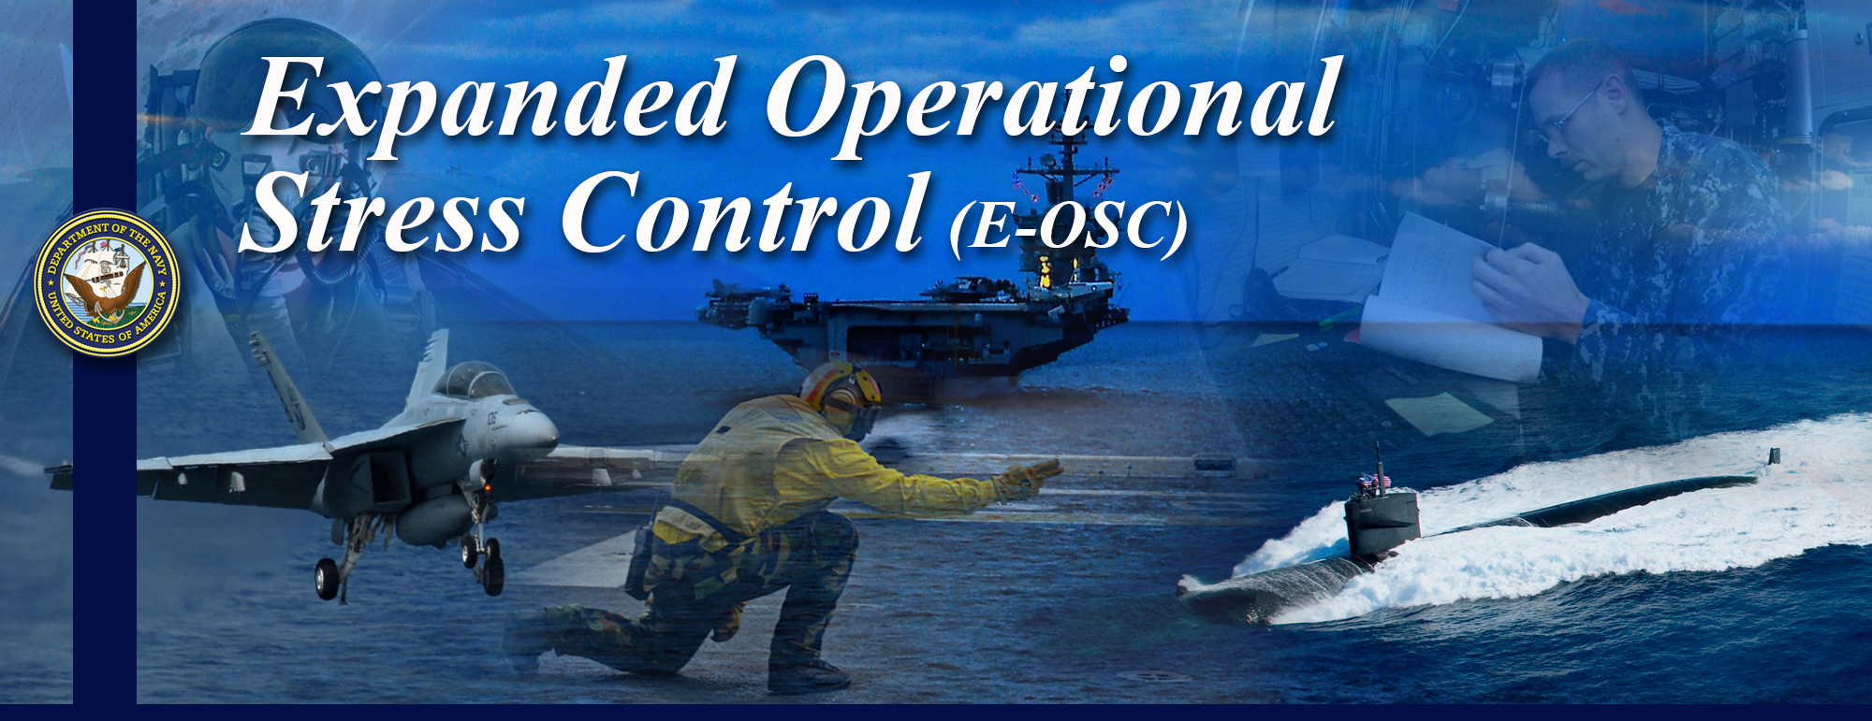
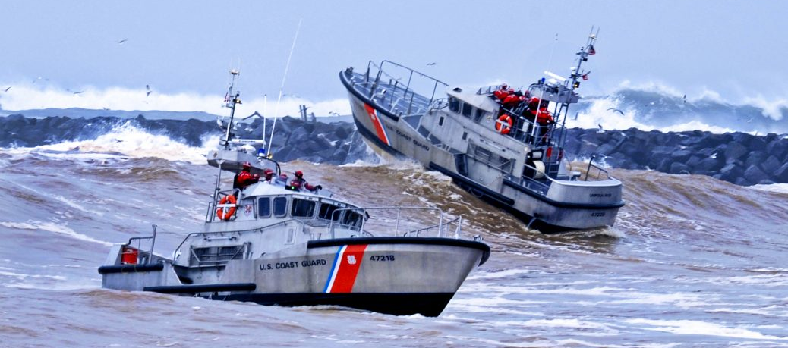

Valued Living
Notes:
Valued Living
Values exist, whether you recognize them or not. Life can be much easier when you acknowledge your values – and when you make plans and decisions that honor them.
Values are usually fairly stable, yet they don't have strict limits or boundaries. Also, as you move through life, your values may change. For example, when you start your career, success – measured by money and status – might be a top priority. But after you have a f family, work-life balance may be what you value more.
When you define your personal values, you discover what's truly important to you. A good way of starting to do this is to look back on your life – to identify when you felt really good, and really confident that you were making good choices.
Some questions that may prompt you in determining when you felt really good and really confident that you were making good choices:
-What were you doing?
-Were you with other people? Who?
-What other factors contributed to your happiness?
-What need or desire was fulfilled?
-How and why did the experience give your life meaning?
-What other factors contributed to your feelings of fulfillment?

Slide 2
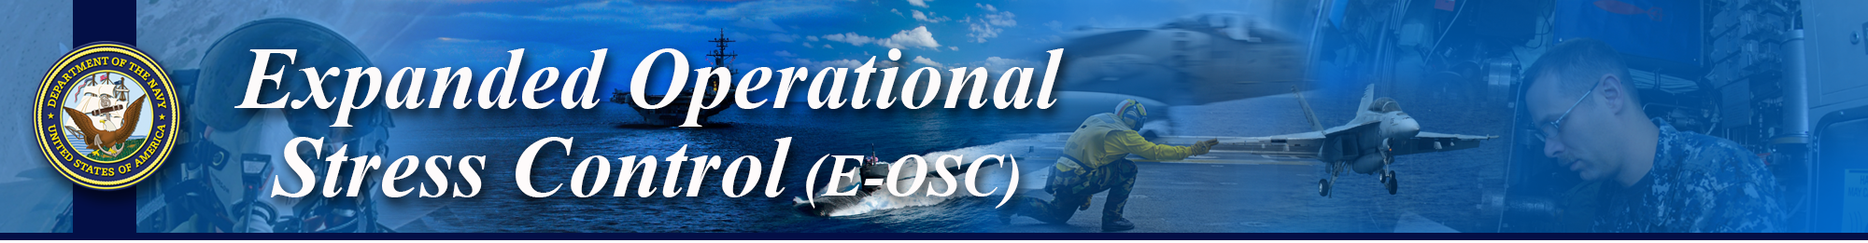

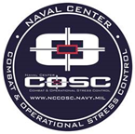
Experiential: Mindfulness Practice
Coast Guard Operational
Stress Control (CG -0SC )
Notes:
Experiential: Mindful Practice

Slide 3
Learning Objectives
Coast Guard Operational
Stress Control (CG -0SC )
DISCUSS and EXPLAIN what values are
EXPLAIN the benefits of living life according to your values
IDENTIFY how values motivate our behaviors
IDENTIFY your personal values
IDENTIFY the CG Core values and DISCUSS how they do or do not align with your personal values
IDENTIFY the CG Core Signature Behaviors
DISCUSS how to balance your personal and organizational values
Notes:
Learning Objectives
DISCUSS and EXPLAIN what values are
EXPLAIN the benefits of living life according to your values
DISCUSS how values motivate our behaviors
IDENTIFY your personal values
IDENTIFY the CG Core values and DISCUSS how they do or do not align with your personal values
IDENTIFY the CG Core Signature Behaviors
DISCUSS how to balance your personal and organizational values

Slide 4
Values
Coast Guard Operational
Stress Control (CG -0SC )
Personal ideals about who we want to be, what we want to do, and how we want to behave in life
Act like an internal compass
They are a direction, not a destination
Fundamental beliefs of a person or organization
Are freely chosen and can change over time
Living by one’s values can make an individual more resilient
When under stress we are more likely to veer off course
Notes:
Values
Discussion Questions:
-What are values and why are they important?
-What matters most to you in this world?
-How does living by our values make us more resilient?
Personal ideals about who we want to be, what we want to do, and how we want to behave in life
Comprise one’s philosophy of life and provide meaning and purpose
The key is to recognize what YOU value, not what others say you should value
Act like an internal compass
They are a direction, not a destination
Fundamental beliefs of a person or organization
Are freely chosen and can change over time
Living by one’s values can make an individual more resilient
When under stress we are more likely to veer off course

Slide 5
Living Life According to Your Values
Coast Guard Operational
Stress Control (CG -0SC )
Help us maintain hope and direction during adversity Provide a sense of meaning and purpose Gain direction in life Reduce emotional discomfort | Improve your ability to make decisions Improve your quality of life Increase happiness Figure out what is truly important to you
Notes:
Living Life According to Your Values
Discussion Questions:
-Do you live a life according to your values?
-Have your values ever conflicted with someone else's?
It is difficult to maintain mental and/or spiritual health when our behaviors differ from our values. When we are not living a life consistent with our values, it can cause us unhelpful emotions and increase stress. Here are a list of benefits that come from a values-driven life.
Help us maintain hope and direction during adversity
Provide a sense of meaning and purpose
Gain direction in life
Reduce emotional discomfort
Improve your ability to make decisions
Improve your quality of life
Increase happiness
Figure out what is truly important to you

Slide 6
Values Influence Behaviors
Coast Guard Operational
Stress Control (CG -0SC )
Behaviors
Attitudes/Beliefs
Values
Notes:
Values Influence Behaviors
Discussion Questions:
-Sometimes individuals behave inconstantly with their values, have you ever experienced this? If so, how did that feel?
Values are the foundation to our attitudes/beliefs which influence our behaviors. Typically, one's behavior make a statement about ones values. It is difficult to behave appropriately when we are not living a life aligned with our values. Living by one's values can make an individual more resilient by helping them make good choices and avoid destructive attitudes/beliefs and behaviors when under stress.
Values are stable long-lasting beliefs about what is important to a person. They become standards by which people order their lives and make their choices.
A belief will develop into a value when the person’s commitment to it grows and they see it as being important.
It is possible to categorize beliefs into different types of values – examples include values that relate to happiness, wealth, career success or family.
A person must be able to articulate their values in order to make clear, rational, responsible and consistent decisions.
Value formations take place throughout life and are influenced by other people and life experiences.
Living by one’s values can make an individual more resilient by helping him or her make good choices and avoid destructive beliefs and behaviors when under stress (social competence), which aids in behaving in a mature and responsible way.
Being committed to one’s values and pursuing important personal goals contribute to hardiness and resilience.
What is a belief?
A belief is an idea that a person holds as being true.
A person can base a belief upon certainties (e.g. mathematical principles), probabilities or matters of faith.
A belief can come from different sources, including:
A person’s own experiences or experiments
The acceptance of cultural and societal norms (e.g. religion)
What other people say
A potential belief sits with the person until they accept it as truth, and adopt it as part of their individual belief system.
Each person evaluates and seeks sound reasons or evidence for these potential beliefs in their own way.
Once a person accepts a belief as a truth, they are willing to defend, it can be said, to form part of their belief system.
What is an attitude?
Attitudes are the mental dispositions people have towards others and the current circumstances before making decisions that result in behavior. People primarily form their attitudes from underlying values and beliefs.
However, factors which may not have been internalized as beliefs and values can still influence a person’s attitudes at the point of decision-making. Typical influences include the desire to please, political correctness, convenience, peer pressure, and psychological stressors.
Bottom line, a lack of self-awareness or critical insight, or the presence of ambivalence or uncertainty about values, can lead to a less rational attitude to choices, and ultimately to undesirable behavior. Hence, knowing what you value is key.

Slide 7
Exercise: Values Clarification
Coast Guard Operational
Stress Control (CG -0SC )
Notes:
Exercise: Values Clarification
Instructor Note:
After participants have finished this worksheet, their is an optional "Life Reflection" script within the LTG. The goal of this script is to help participants build insight in what is meaningful to them.
The goal of this exercise is to help participants identify their personal values and determine if they are living a life aligned with their values.
Directions:
Circle behaviors that you personally value from the list below. If you do not see something on the list that you value, use the blank spaces to write-in your own. Next, select your top 3 most important values, and write them down in the box below. Next to each value write down behaviors and actions that support your values.
Time Allotted: 10 minutes
Discussion Questions:
-What do you value most?
-What are your top 3 values?
-How do your daily actions align with your values?
-Are you truly living by your values?

Slide 8
CG Core Values & Signature Behaviors
Coast Guard Operational
Stress Control (CG -0SC )
Signature Behaviors
Core Attributes
CG Core Values & Ethos
Notes:
CG Core Values and Signature Behaviors
We previously reviewed the CG’s Core Values, Ethos, Core Attributes and signature behaviors and how they contribute to the CG's perpetual mission is to "maintain, train, and equip the most effective combat-ready naval forces capable of winning wars, deterring aggression, and maintaining freedom of the seas."
This is demonstrated through:
CG Core Values: Honor, respect & devotion to duty
CG Core Ethos: We Protect, We Defend, We Save
"THE UNITED STATES COAST GUARD GUARDIAN ETHOS" I am America's Maritime Guardian. I serve the citizens of the United States. I will protect them. I will defend them. I will save them. I am their Shield. For them I am Semper Paratus. I live the Coast Guard core values. I am a Guardian. We are the United States Coast Guard.
CG Core Attributes(Four attributes to help serve as guiding criteria for our decisions and actions): Integrity, accountability, initiative, & toughness
In order to stay on course and make our Core Values, Ethos and Core Attributes more relatable and actionable, we have defined 10 Signature Behaviors to help guide and make the force better, in both our everyday missions and when navigating stormier seas.
Treat every person with respect
Take responsibility for my actions
Hold others accountable for their actions
Intervene when necessary
Be a leader and encourage leadership in others
Grow personally and professionally every day
Embrace the diversity of ideas, experiences, and backgrounds of individuals
Uphold the highest degree of integrity in professional and personal life
Exercise discipline in conduct and performance
Contribute to team success through actions and attitudes

Slide 9
Balancing Values
Coast Guard Operational
Stress Control (CG -0SC )
CG Core Values & Ethos
Personal Values
Signature Behaviors
Notes:
Balancing Values
Discussion Questions:
-Do your personal values align with the CG's core values & signature behaviors?
-How do you balance your personal and organizational values?
Every service member has personal and CG values that they live by. When faced with situations that might challenge any of the CG core values, they will likely turn to their personal values to help them through that situation.
Value congruence or alignment occurs when individuals express positive feelings upon encountering others who exhibit values similar to their own. When values differ, conflicts over goals and the means to achieve them may result.
Personal integrity is about “walking-the-walk and talking-the-talk”—meaning, an individual lives consistently with their principles.
Personal integrity involves weighing the balance of our personal convictions and values along with the charge before us as leaders and representatives of the United States CG. Personal integrity often requires an individual to put aside personal preferences and natural tendencies and take the high road.
Personal integrity requires paying a price. It is often much easier to go along with the crowd, take the easy way out, turn your back, look the other way, or not rock the boat. But in the long run, standing for your personal integrity brings the personal satisfaction of knowing you stood for that which is more enduring.
An individual’s personal integrity will be tested, often repeatedly. Anyone who chooses to be a leader will face more tests of personal integrity. This is why it is important to know what your guidelines are, to know what your values and principles are.

